Slide 1
Name: Swapnil Ghosh
Dept: IT
Roll No: 001911001067
PROGRAM 1

Slide 2


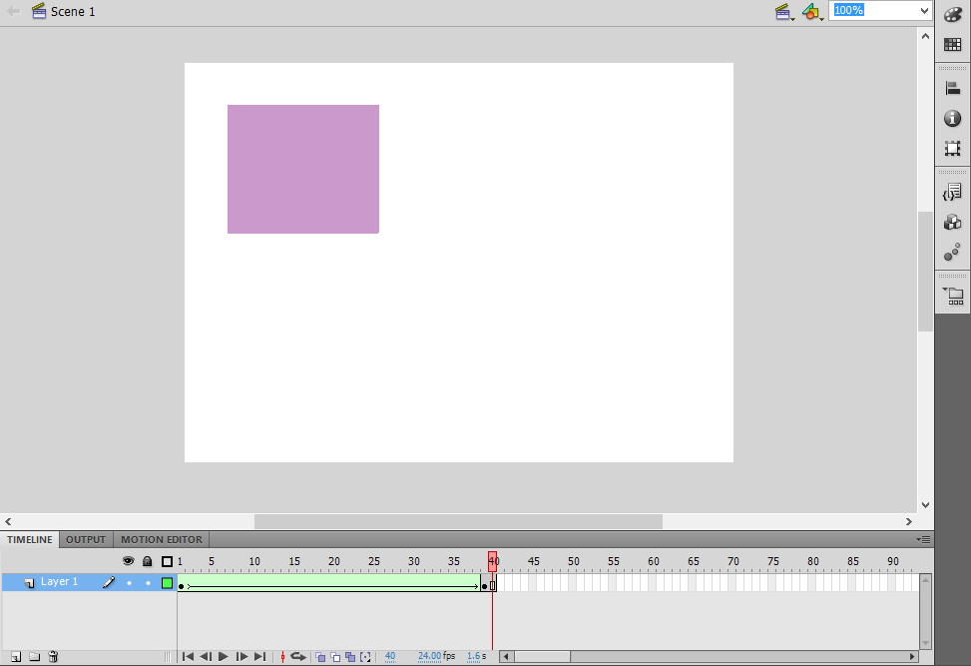
Opened flash document.
2. Selected the circle tool from the tool bar and draw a circle on the work area and
coloure it.
3. Click on the 40th key frame-> insert new key frame.
4. Selecting the last key frame->draw a rectangle on the circle by selecting the rectangle
tool bar so that it will cover the circle. colour the rectangle by the different colour.
5. Again click on the last frame->under properties->under tween->change the option shape from none.
6. Then again select the 39th frame->go to properties->tween->change to shape.
7. Go to control->test movie->see the circle changing in to rectangle.

